Slide 1
DNS, DNSSEC, DANE, DPRIVE
IETF 94 Hackathon
Results!

Slide 2
DNS Team Hackathon Projects
DNS Privacy topics
getdnsapi extension (call debugging) implemented with changes so user learns transport/privacy results
edns0-client-subnet privacy election
edns0-padding option (implementation under way)
Check TLS at Recursive - node.js application
DNSSEC topics
DNSSEC roadblock avoidance – proposed new extension for getdnsapi
CDS/CDNSKEY -
…

Slide 3
DNS Team Hackathon Projects
DANE-related
Sketch for OPENPGPKEY RRs in an ietf.org zone for IETF’s role-based email addresses – Allison Mankin and Tomofumi Okubo
Other
getdns built for OpenBSD – Melinda Shore
getdns brew formula updated – Matt Miller
getdns PHP bindings updated to new release features – Scott Hollenbeck
Miscellaneous engagements with other tables

Slide 4
DNS Privacy
Every Internet flow begins with queries to DNS
DNS queries are meta-data
Example of user exposing possible travel planning
Someone monitoring
A? AAAA? hotel.example.berlin
A? AAAA? buytix.example.de

Slide 5
DNS Privacy
DNS queries are meta-data
A? AAAA? hotel.example.berlin
A? AAAA? buytix.example.de

Slide 6
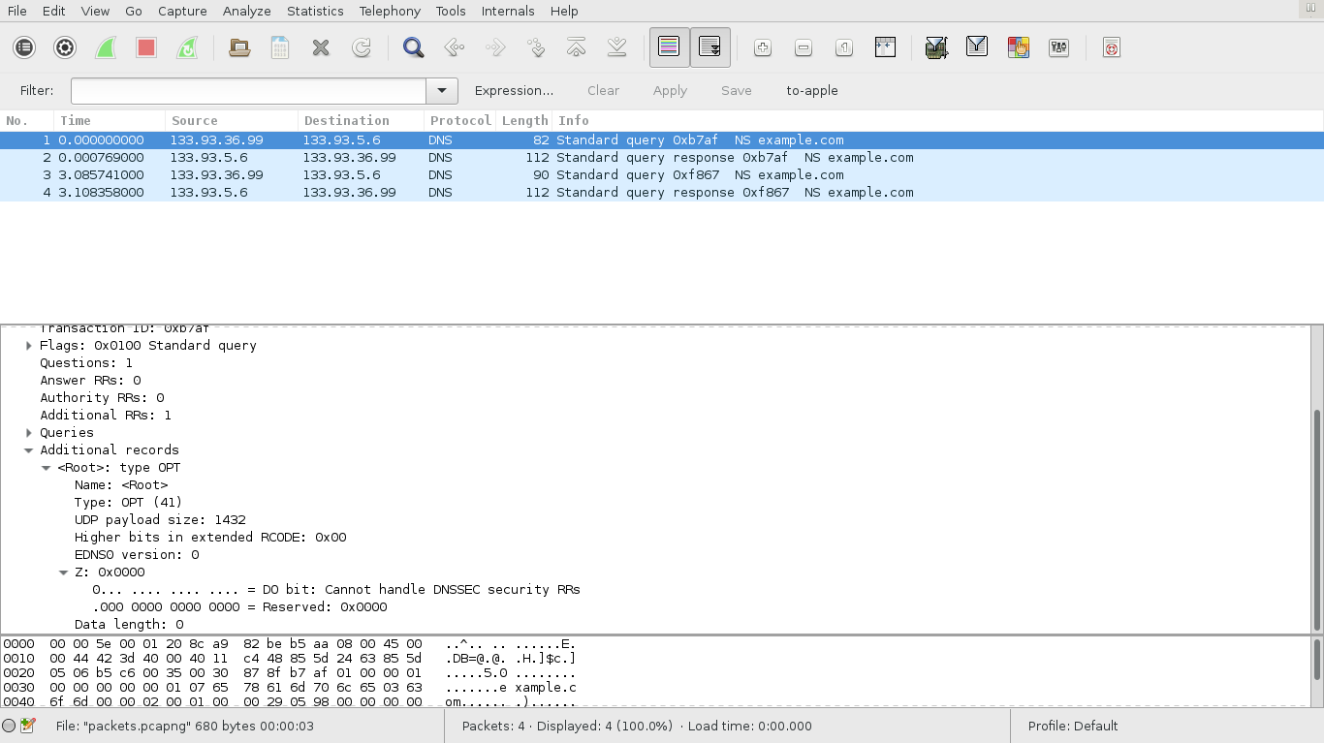
Client Privacy from draft-ietf-dnsop-client-subnet-04 - Daniel Kahn Gillmor (DKG)

Slide 7
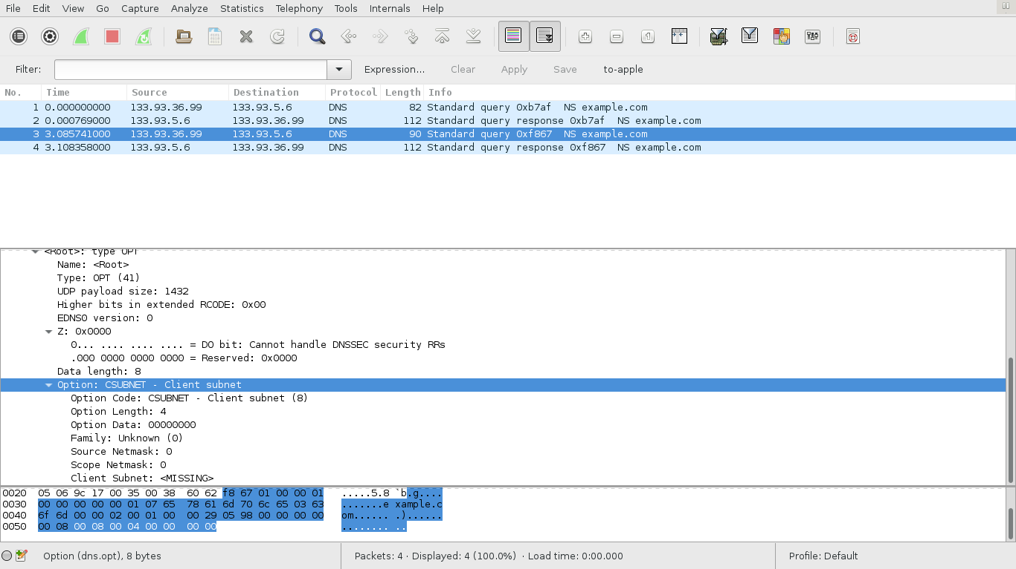
Client sends value of 0 to opt out

Slide 8
John/Sara Dickinson - Transport and Privacy Results from getdns

Slide 9
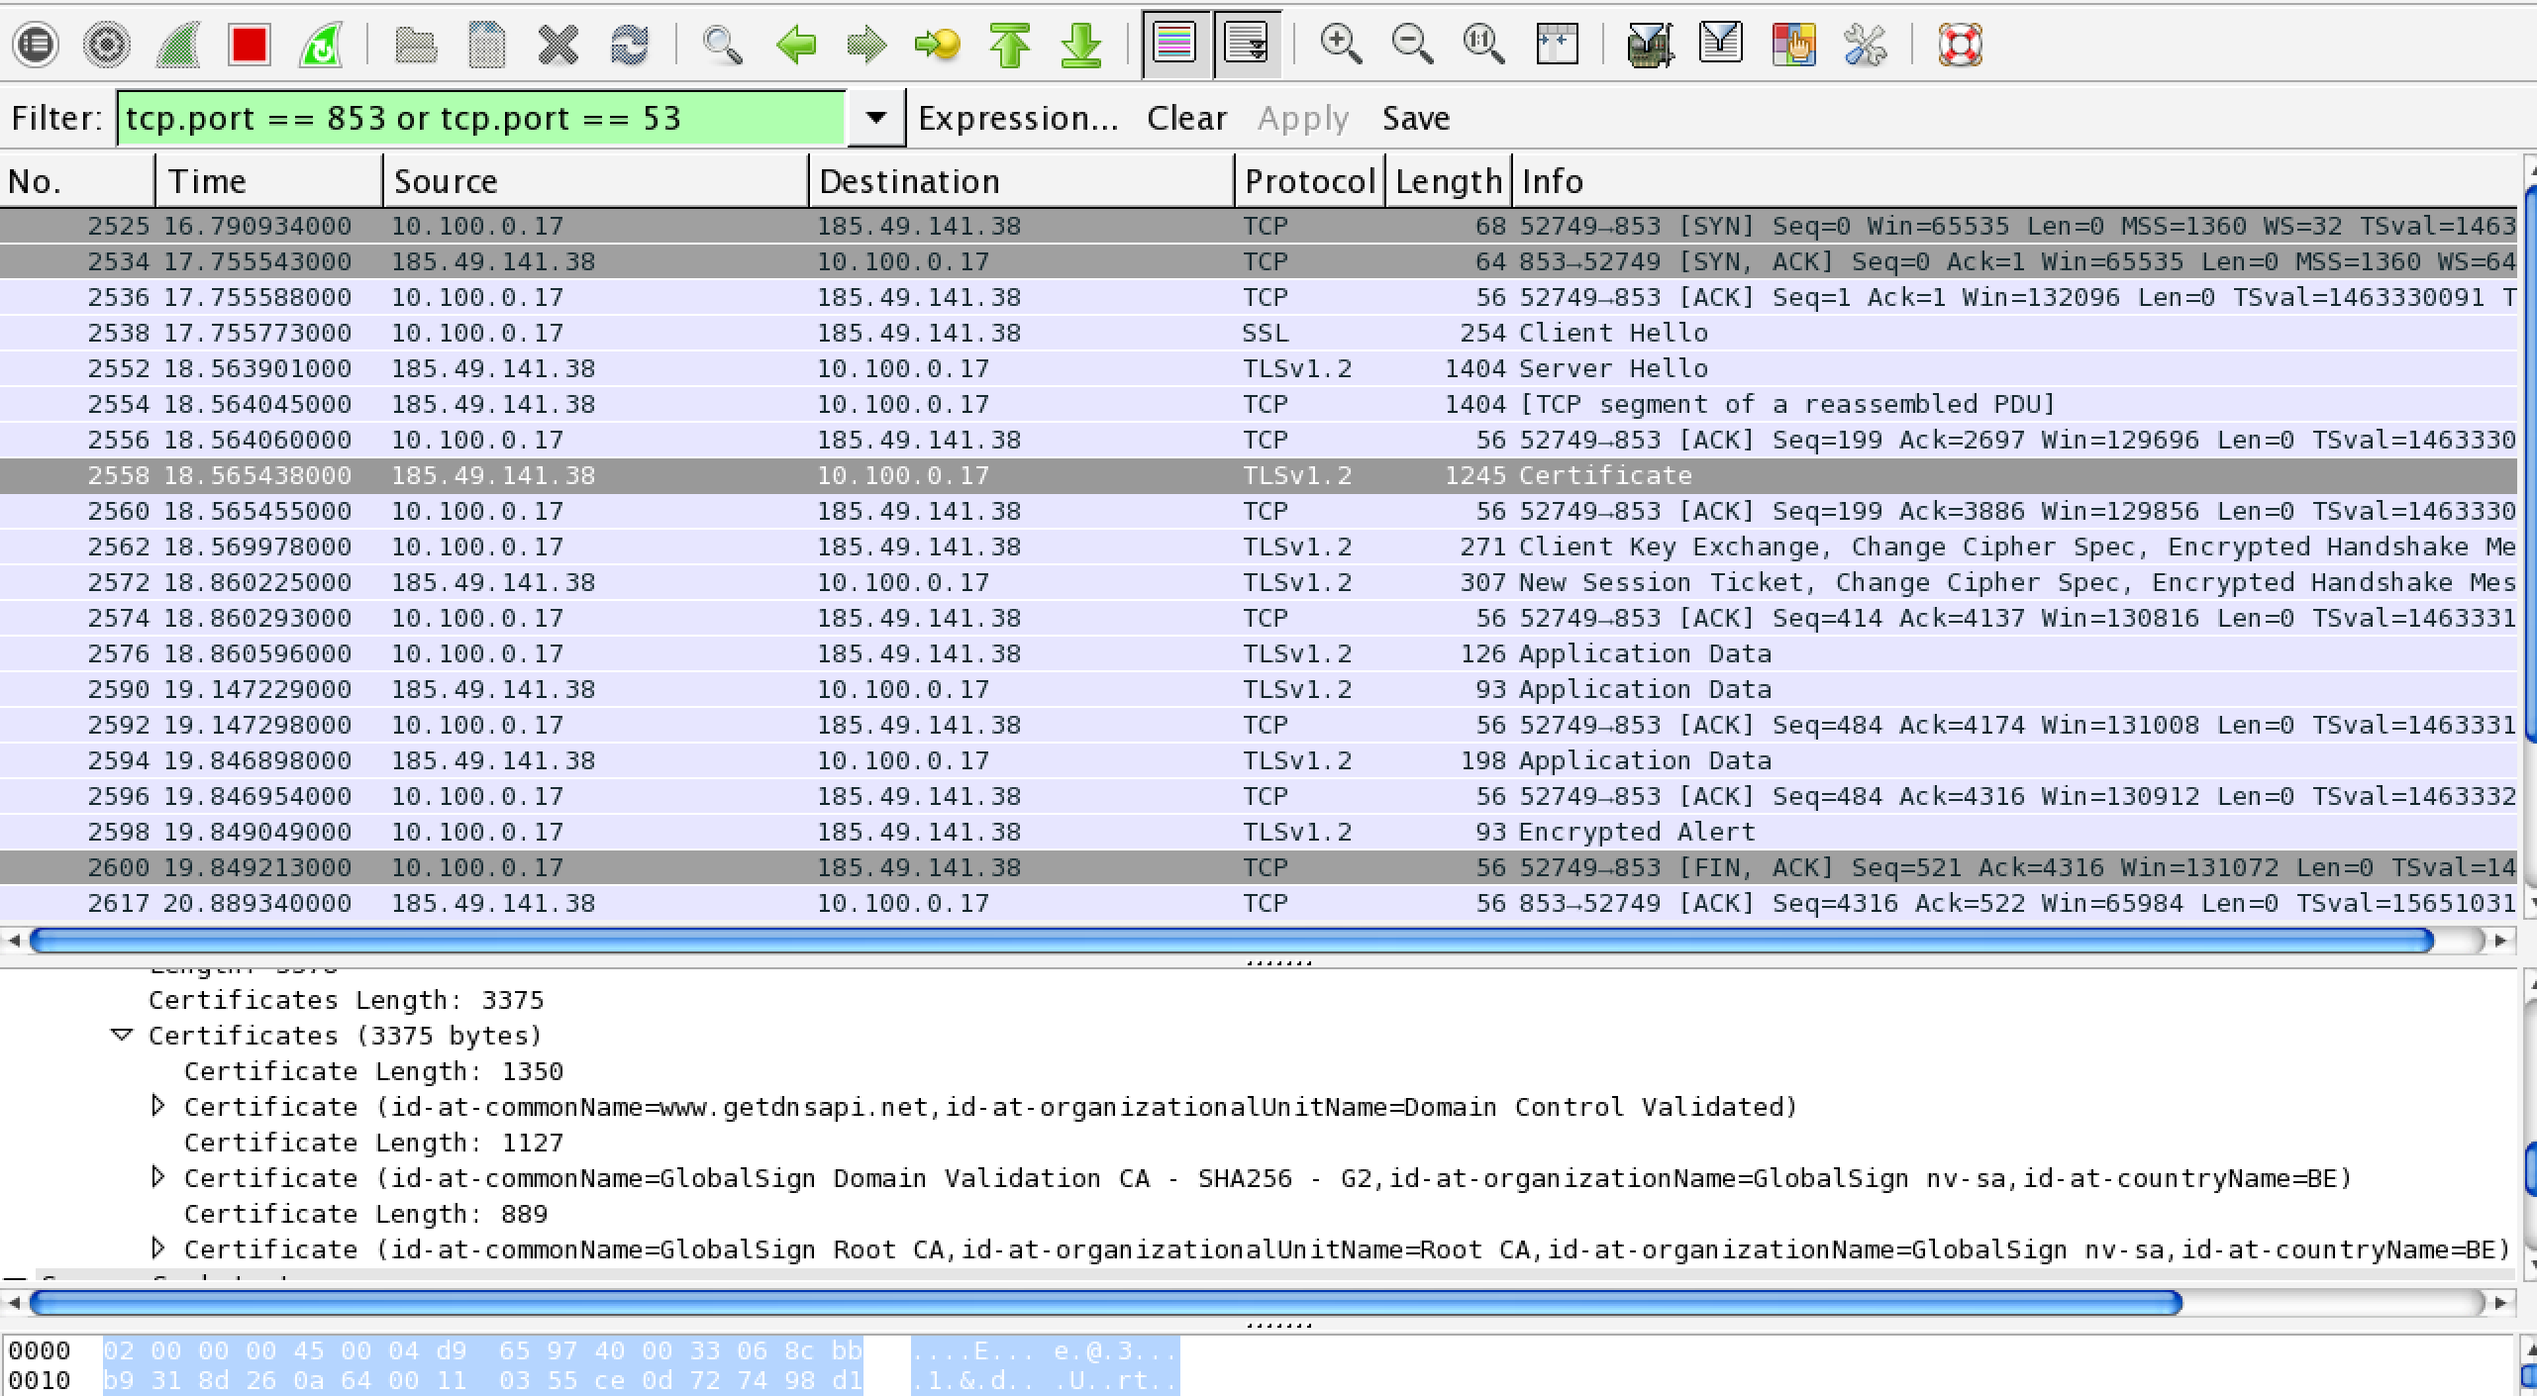
Gowri Visweswaran/Sara Dickinson – getdns node.js Tool to Check TLS at Recursive

Slide 10
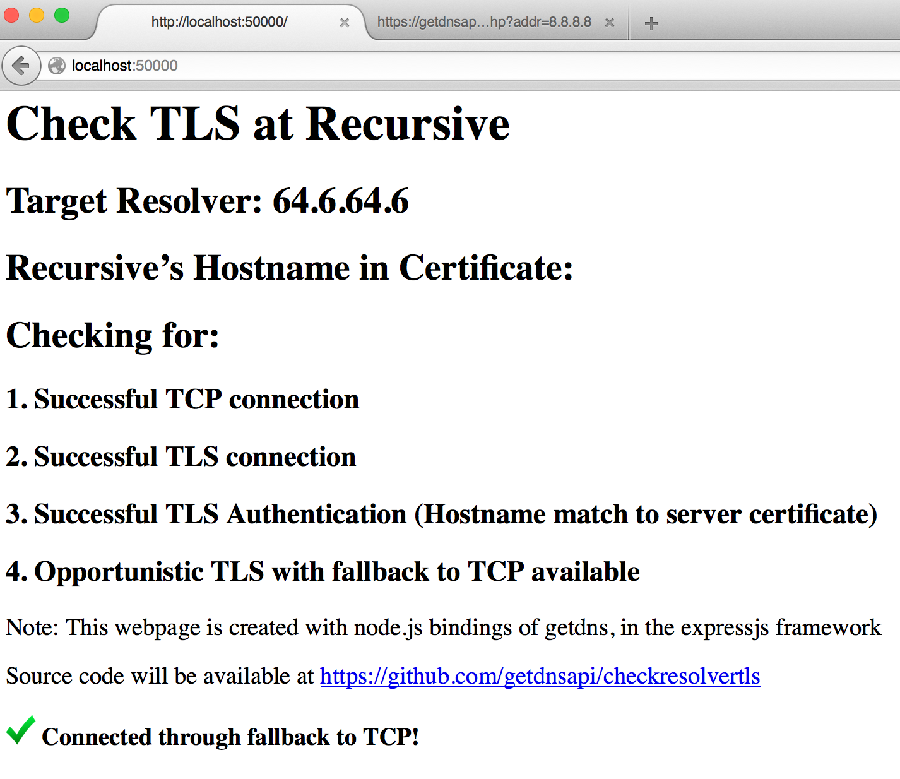
(draft-ietf-dprive-dns-over-tls)

Slide 11
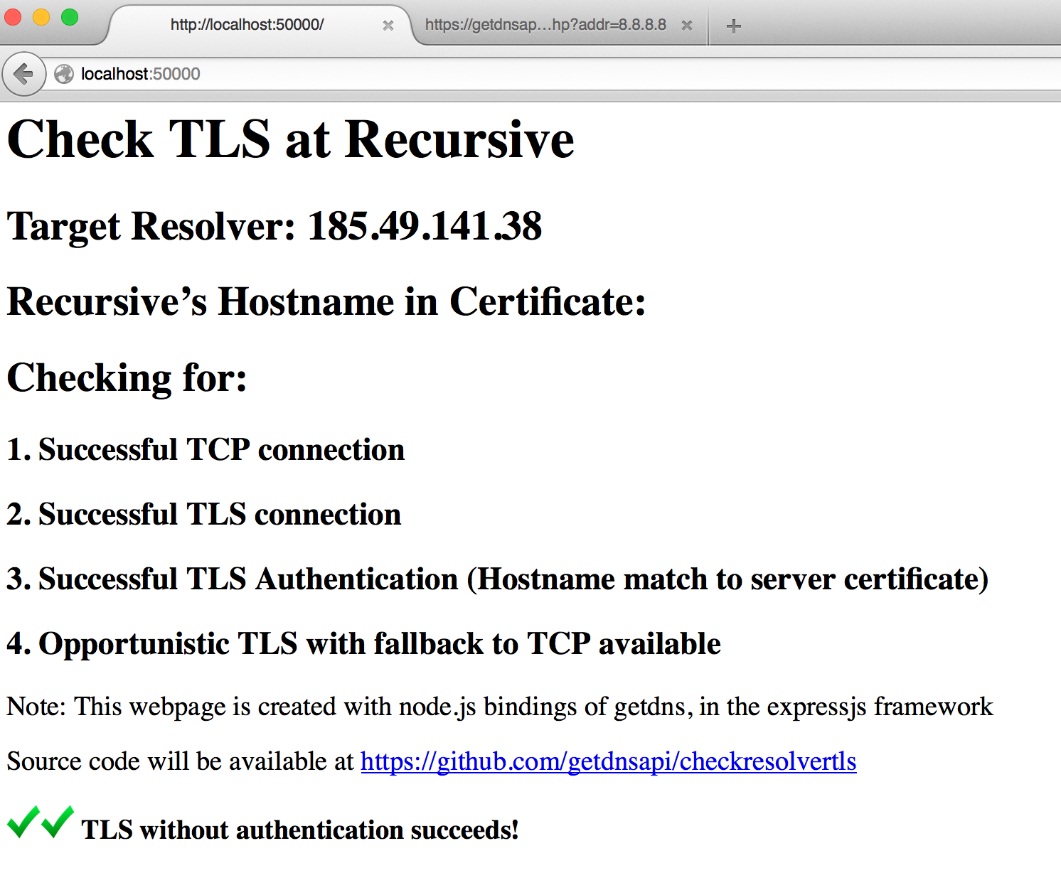

Slide 12
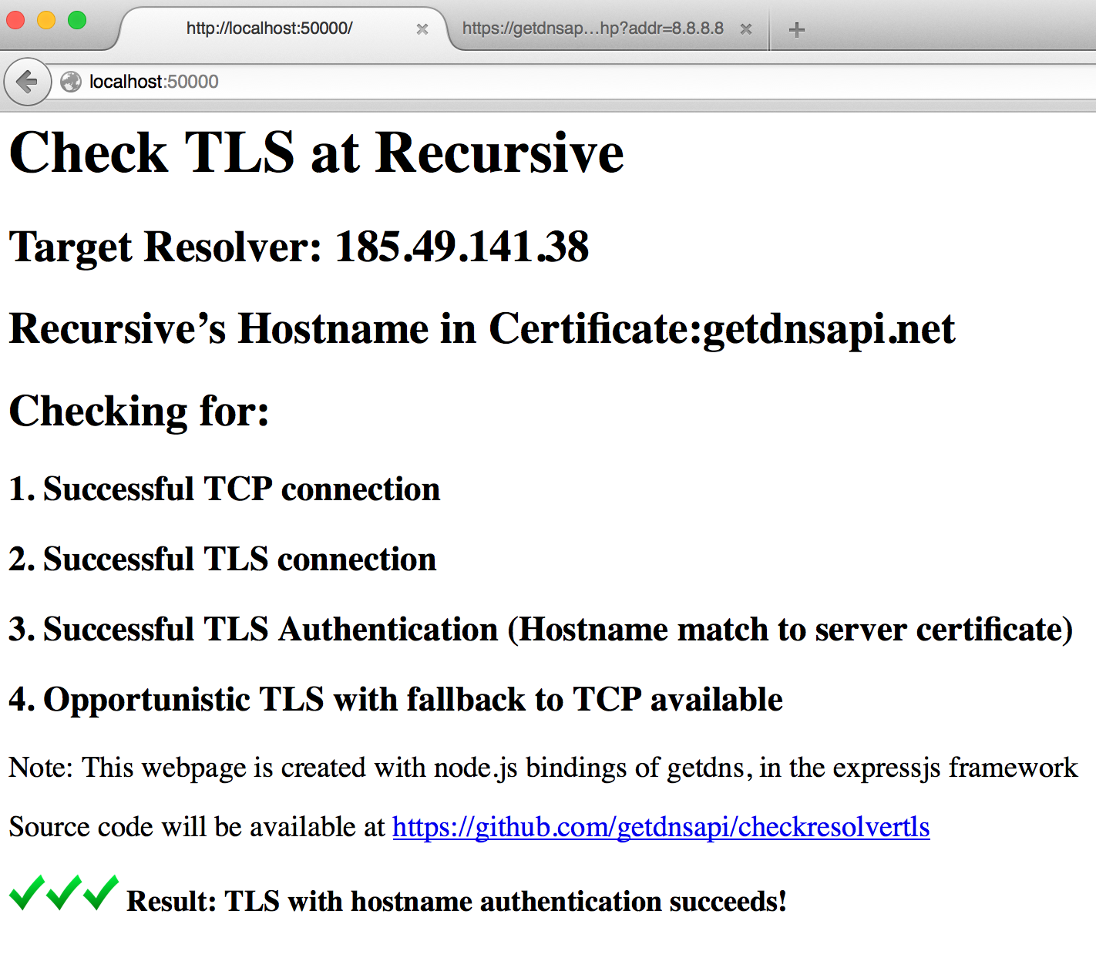

Slide 13
Extra Motivation for DNSSEC as well as DNS Privacy Work

Slide 14
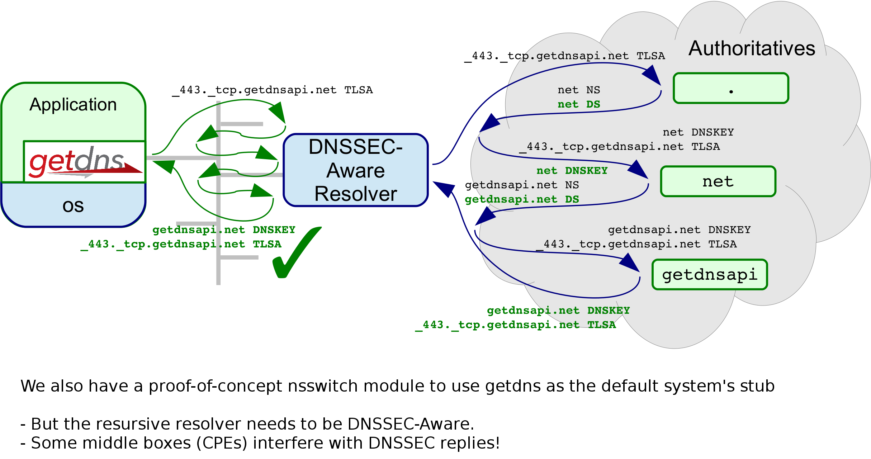
Willem Toorop/Benno Overeinder - DNSSEC Roadblock Avoidance
The recursive resolver needs to be DNSSEC-Aware
There are many middle boxes and others that are not.
draft-ietf-dnsop-dnssec-roadblock-avoidance

Slide 15
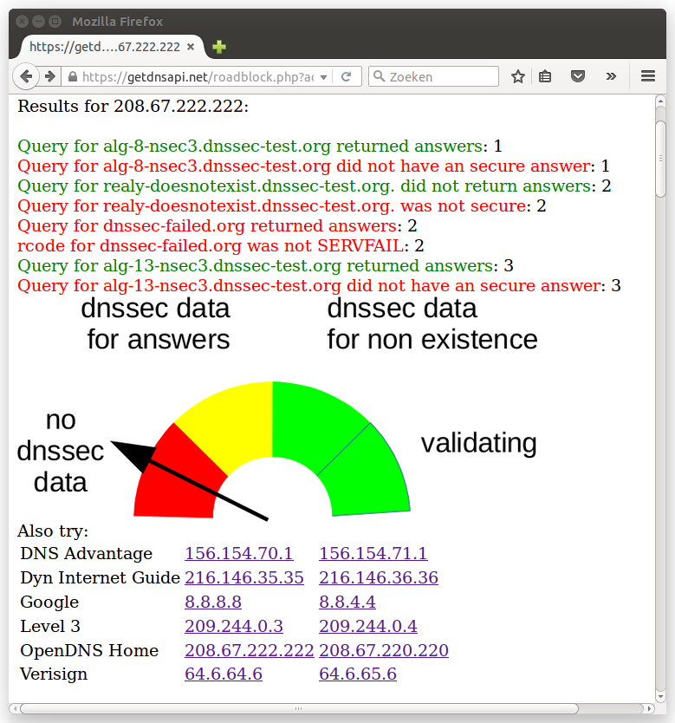

Slide 16
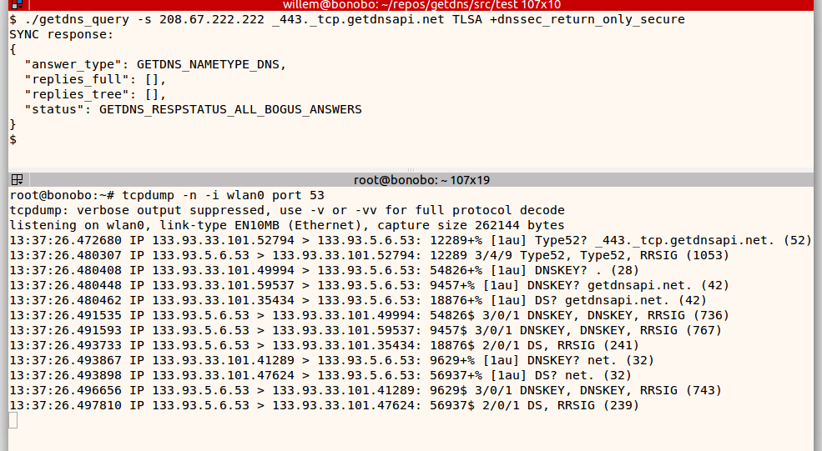
Roadblock

Slide 17
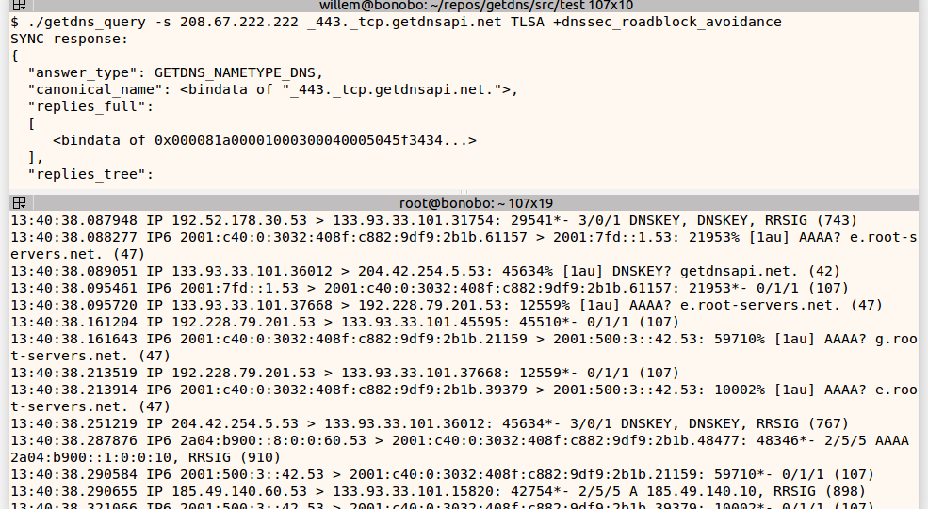
Roadblock Avoidance
Getdns release candidate containing this later this week!

Slide 18
Shumon Huque and Jan Včelák - CDS Monitor

Slide 21
Champions and More Champions
Dickinson, Sara
Kahn Gillmor, Daniel
Mankin, Allison
Shore, Melinda
Toorop, Willem
Wicinski, Tim
Včelák, Jan
Cathrow, Andy
Dickinson, John
Huque, Shumon
Miller, Matt
Tomofumi Okubo
Overeinder, Benno
Seltzer, Wendy
Visweswaran, Gowri

